Slide 1
POWERBI DASHBORD
Discription:
The power bi dashboard describes the analysis of corona dataset of india to know the situation of indian in pandemic time(corona)

Slide 2
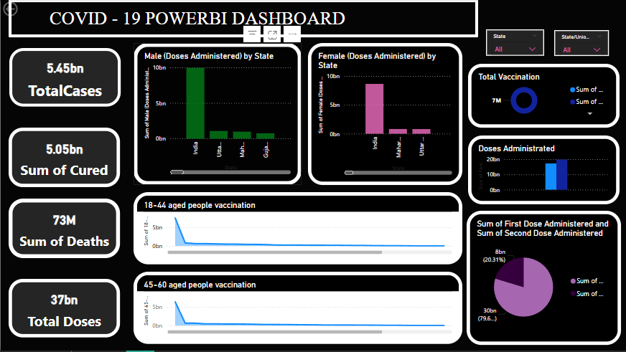
OVERVIEW OF POWERBI DASHBOARD

Slide 3
THANK YOU

